Slide 1
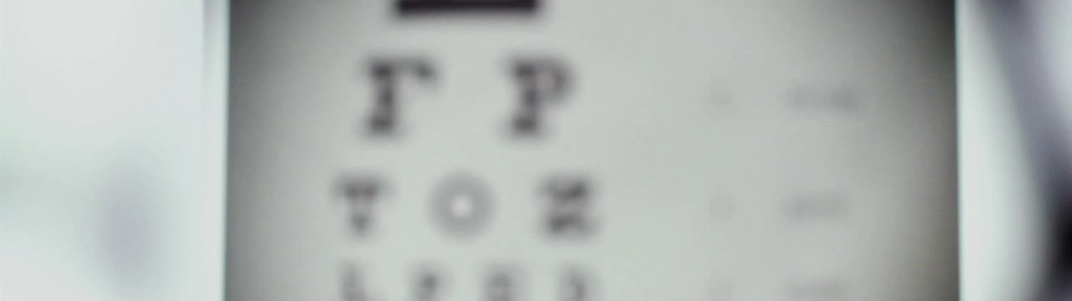
Enhancing Eye Disease Detection with MViT and SWD Loss
Name: Alli KHADGA JYOTH
Roll.no: 19024
Advisor: DR. Akshay Agarwal

Slide 2
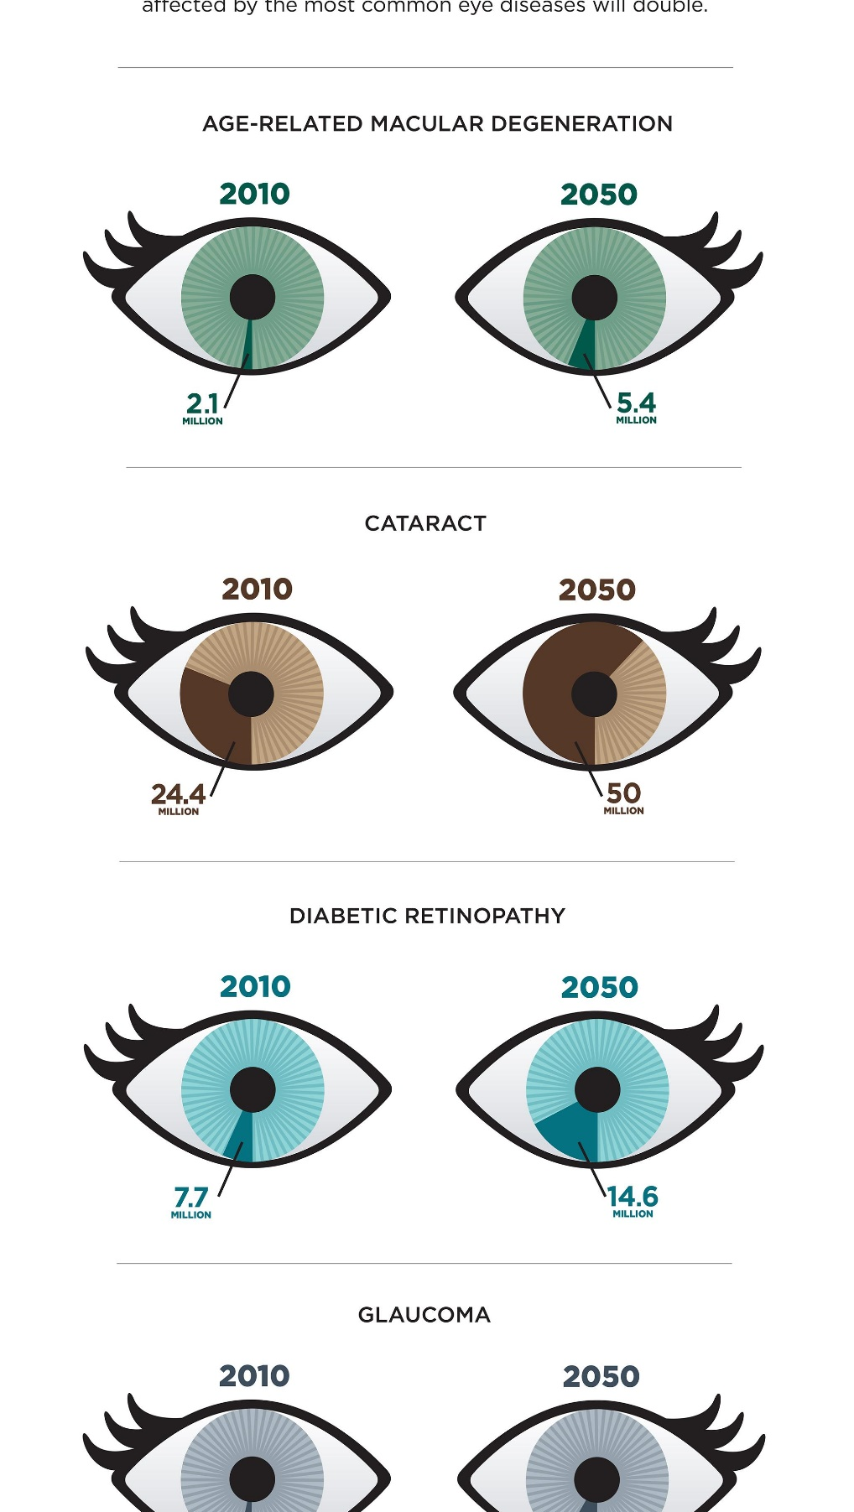
Intro & Motivation:
Eye diseases are becoming more prevalent due to aging-related problems and increased life expectancy
Automated methods for early detection and diagnosis of eye diseases are becoming increasingly important, and deep learning techniques have shown promise in medical image analysis
Automated classification of eye diseases can potentially assist ophthalmologists in diagnosing diseases accurately and efficiently, reducing the time and specialized expertise required for manual diagnosis
Knowledge distillation is one way of improving the performance of the model with reducing the complexity.
Sample-wise distillation is not fully explored in Literature

Slide 3
Literature Work
Literature | Review
EyeDeep-Net: a multi-class diagnosis of retinal diseases using deep neural network Sengar, Neha, et al. "EyeDeep-Net: a multi-class diagnosis of retinal diseases using deep neural network." Neural Computing and Applications (2023): 1-21. | EyeDeep-Net: a custom-built Deep Learning architecture to detect Diabetic retinopathy (DR), Media Haze (MH) or Optic disc cupping (ODC) and Normal eyes. Trained on subset of RFMiD dataset
Multi-Task Knowledge Distillation for Eye Disease Prediction Chelaramani, Sahil, et al. "Multi-task knowledge distillation for eye disease prediction." Proceedings of the IEEE/CVF Winter Conference on Applications of Computer Vision. 2021. | The study proposes to use a novel multi-task learning approach for Eye disease prediction. In the paper they use ensemble of teachers trained on different tasks to train the student model to perform all the tasks. The 3 tasks are 5 class classification, 320 fine-grained classification, generating textual diagnosis. They use supervised and semi-supervised methods to train the model on labelled and un-labelled images.
Self-speculation of clinical features based on knowledge distillation for accurate ocular disease classification He, Junjun, et al. "Self-speculation of clinical features based on knowledge distillation for accurate ocular disease classification." Biomedical Signal Processing and Control 67 (2021): 102491. | The paper proposes a knowledge distillation method to learn the clinical features which can be essential for eye disease classification. In the paper a teacher model is trained with both the bilateral CFP images (images of both eyes) and the clinical features associated with them like age and sex of the person, but the student model is only trained on the CFP images and is trained to infer/learn to speculate about the clinical features.

Slide 4
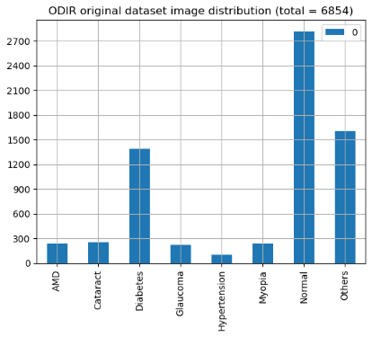
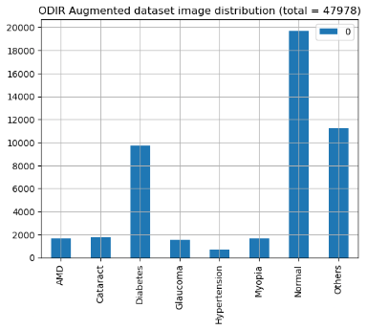
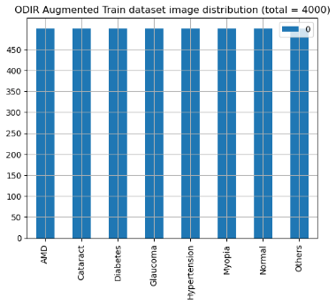
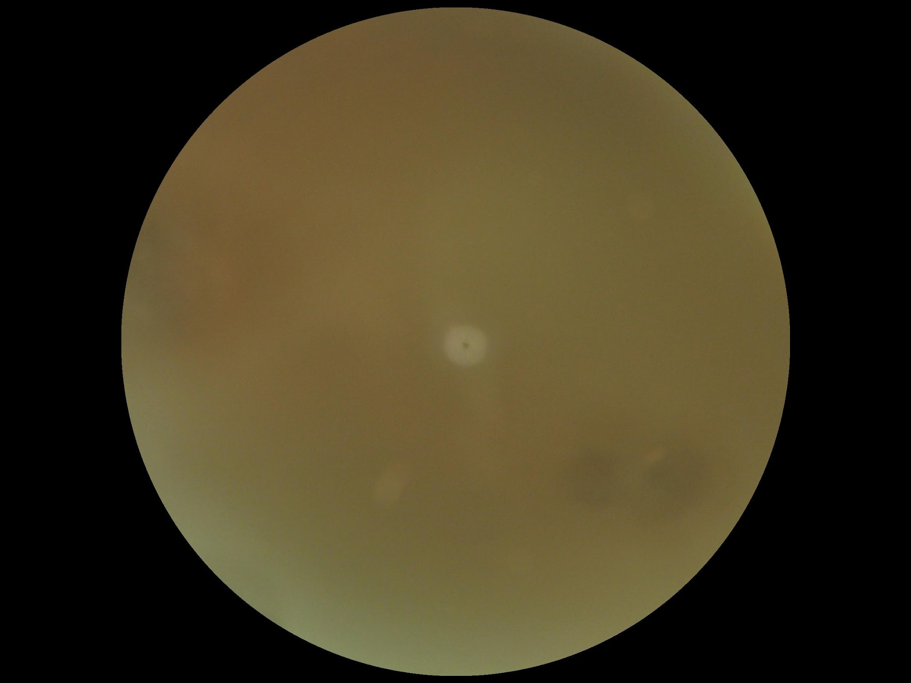
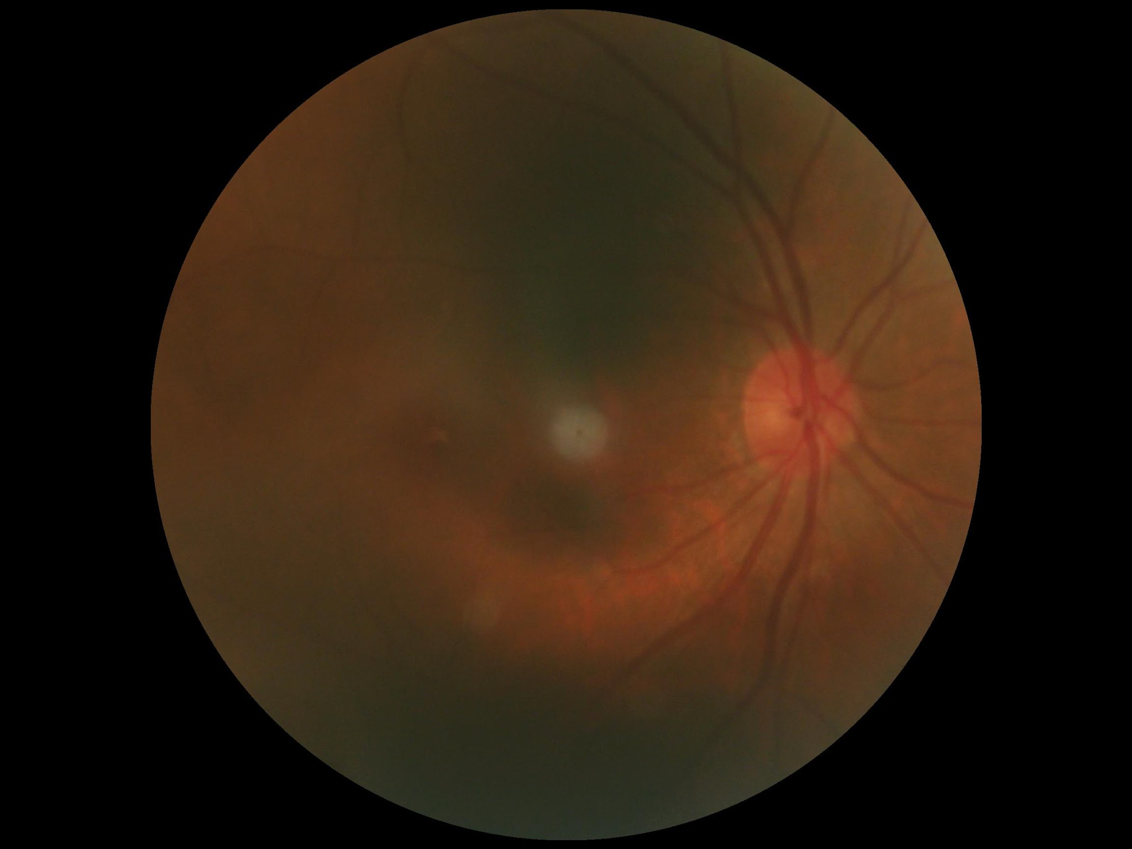
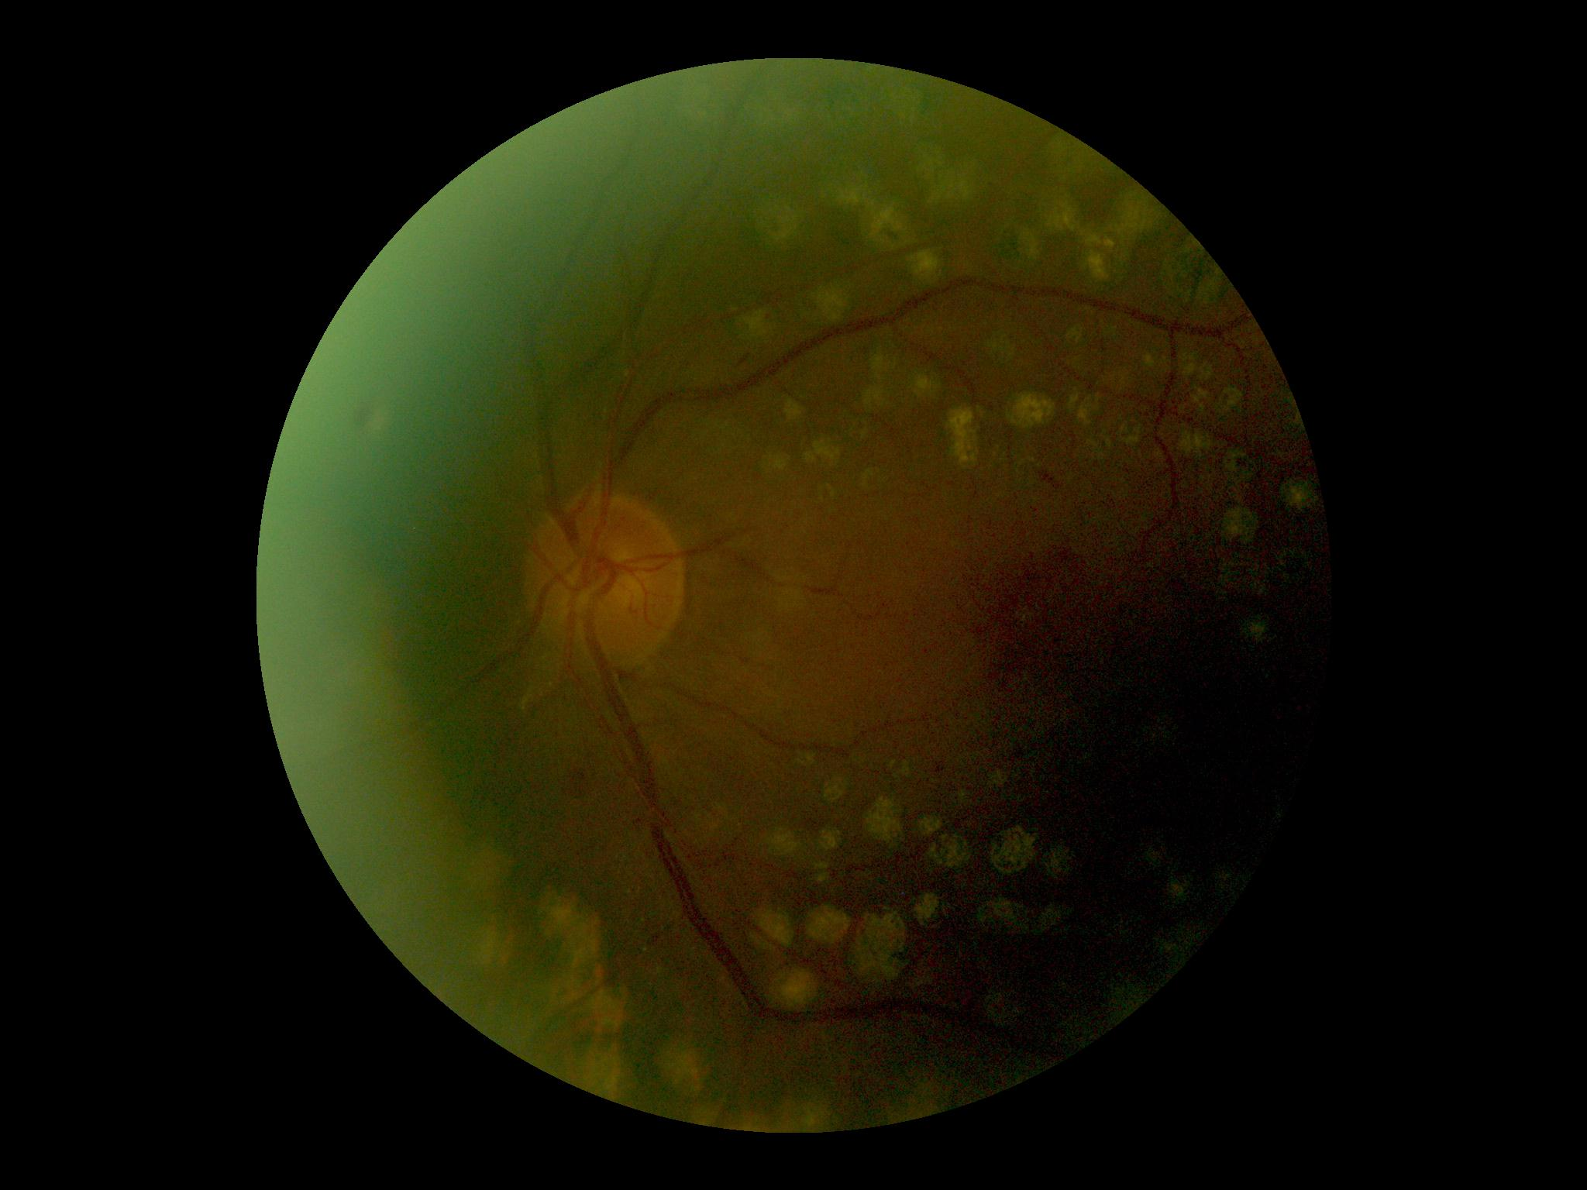
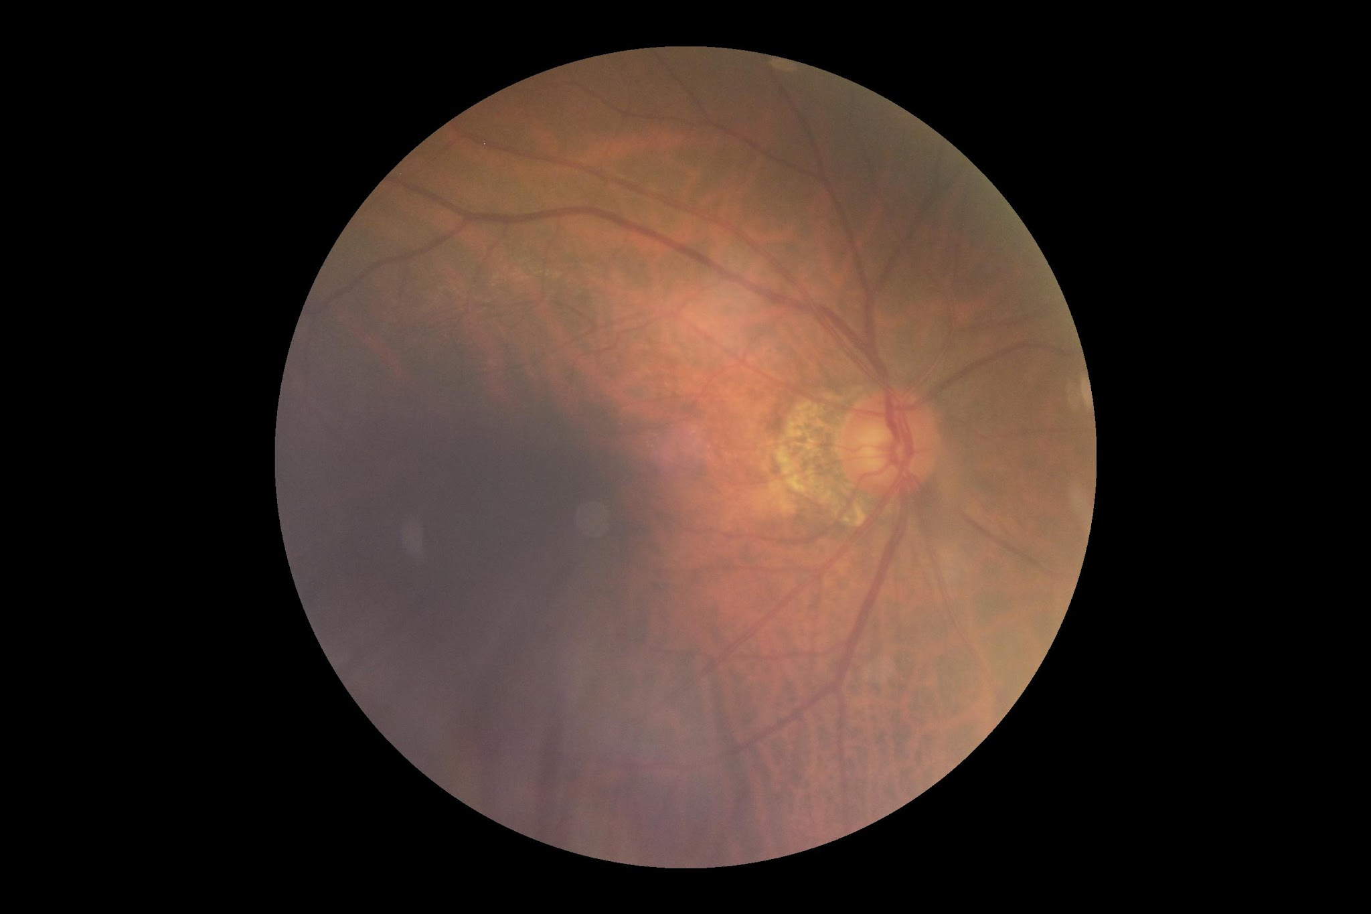
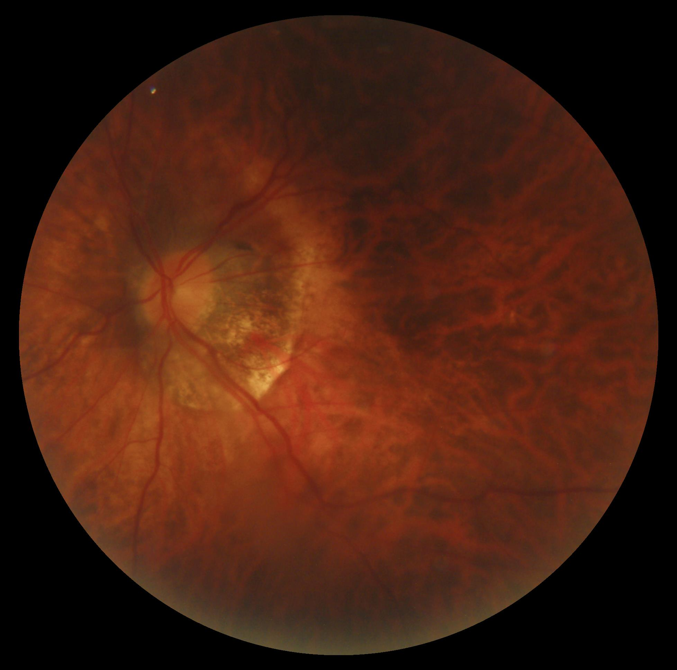
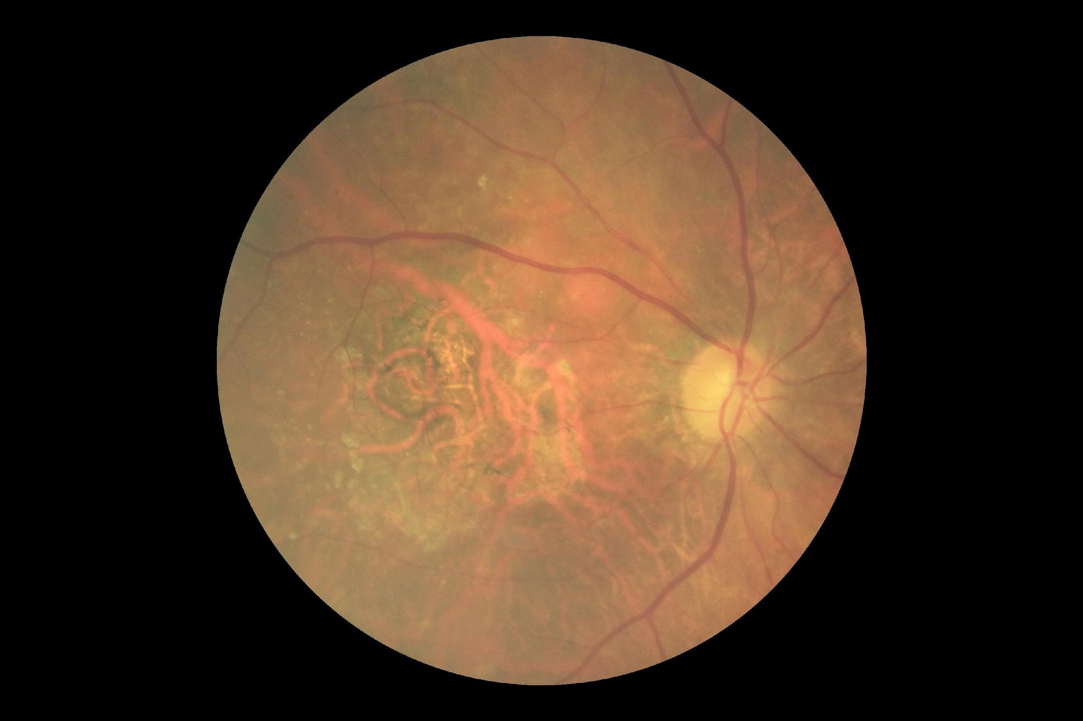
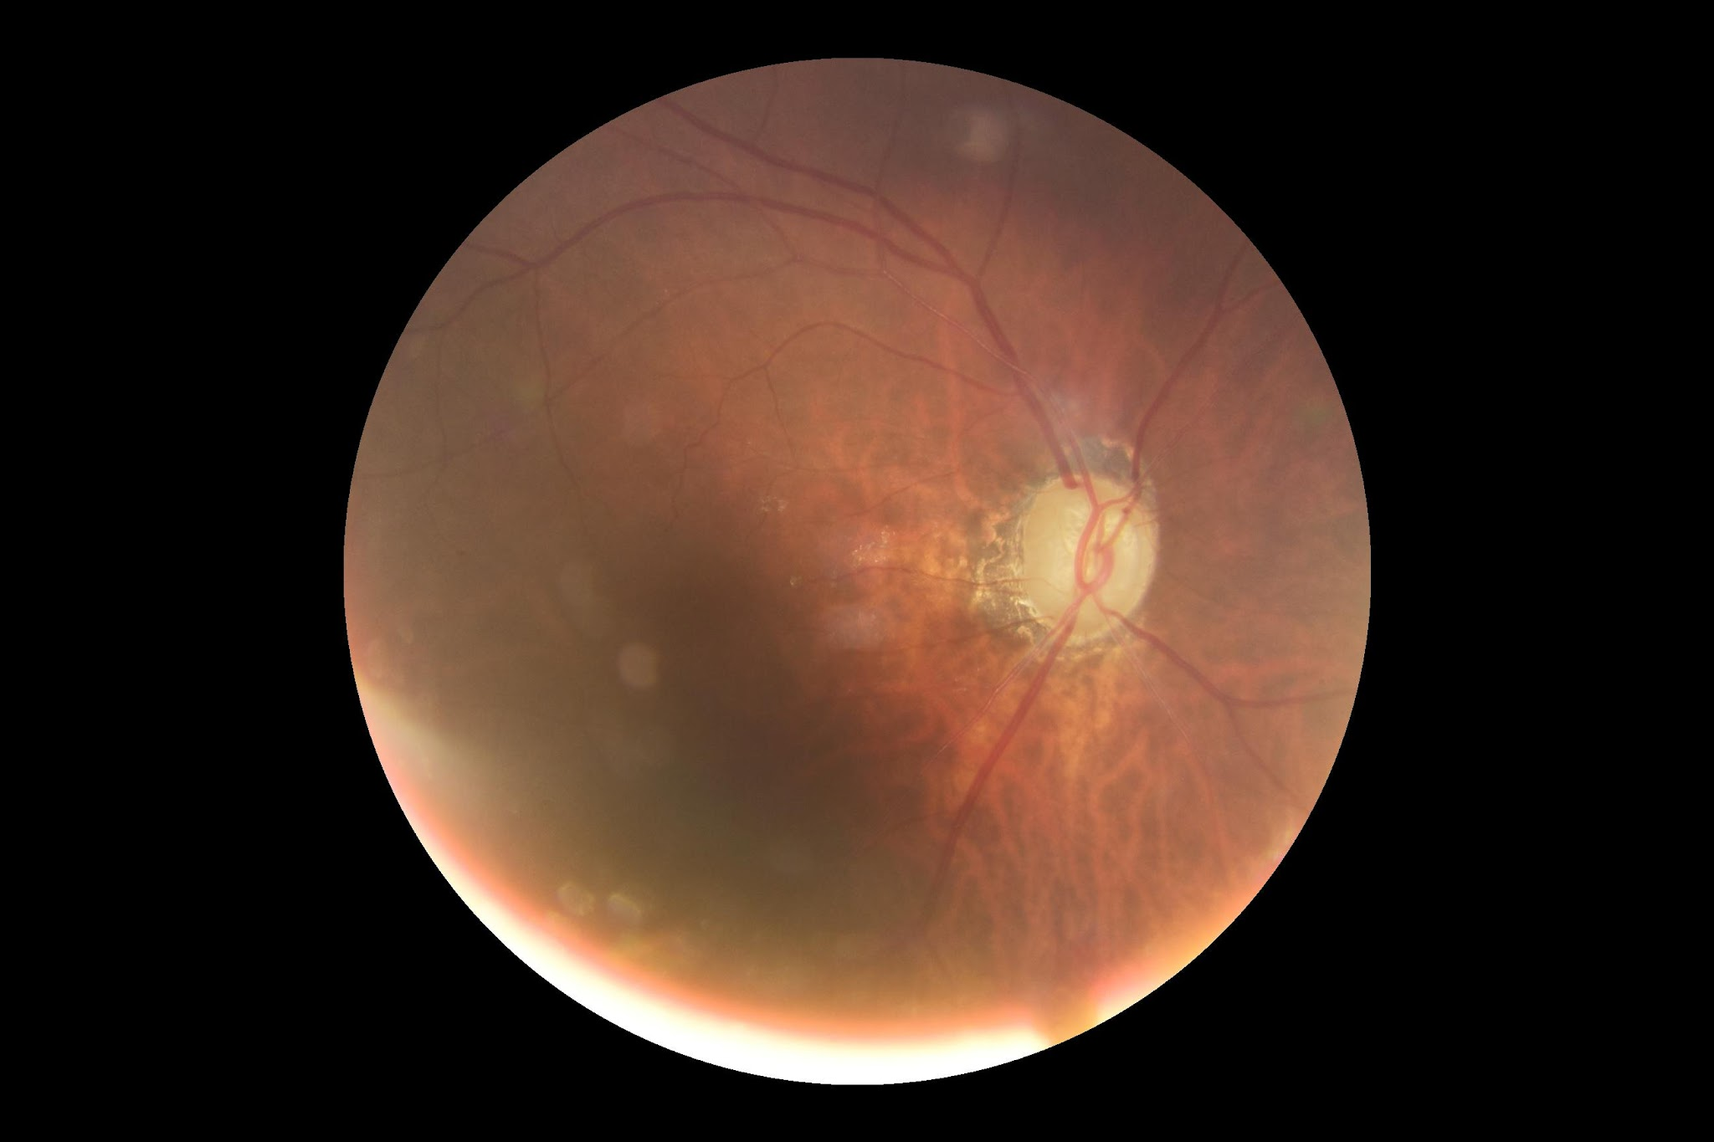
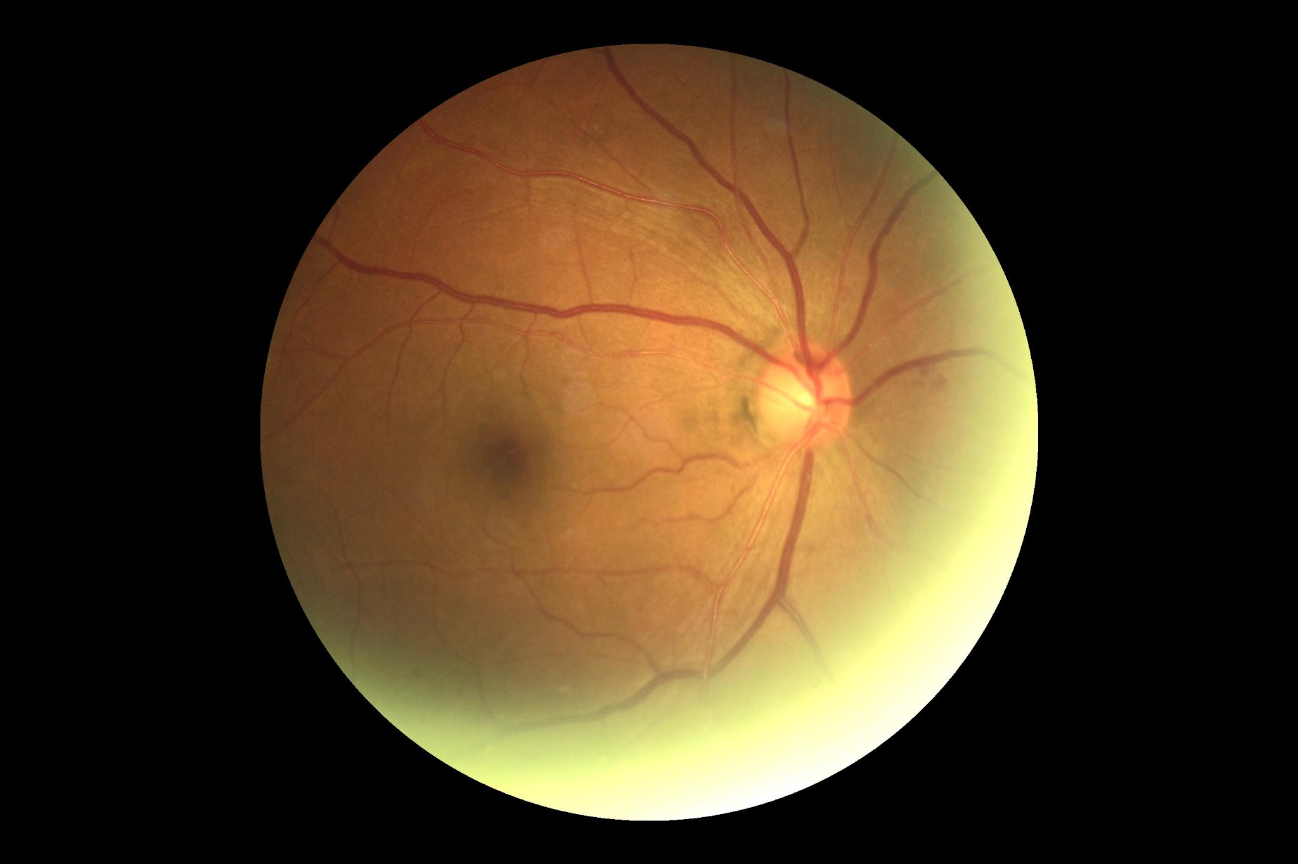
ODIR Dataset
Ocular Disease Intelligent Recognition dataset contains images of the left and right fundus from 5000 patients.
Each image is classified into 8 labels.
The dataset is divided into 7000 images in the training set and 1000 images in the testing set

Slide 5
ODIR Processing & Augmentation
Dataset | Details | Method | Specifics | Total | Train | Test
ODIR | Classes: 8 | Original | Multi-labelled & imbalanced | 8000 | 7000 | 1000
 | Classes: 8 Added non-common class images from RFMiD dataset to “Other” class | Pre-process | Removed multi-labelled images Removed images with no training labels | 6854 | 5483 | 1371
 | Removed classes with less than 10 images Added non-common class images from ODIR to “Other” class | Augmented & Resample | 500 images per class | 5600 | 4000 | 1600

Slide 6
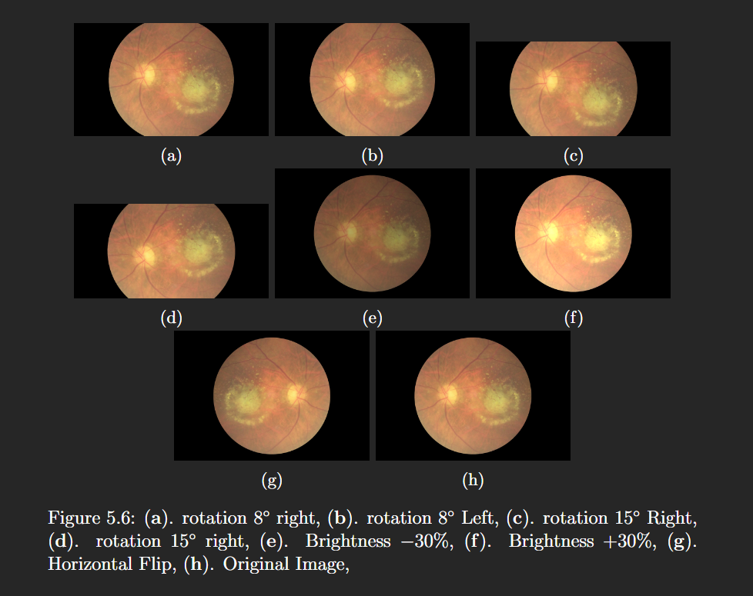
Data Augmentations

Slide 7
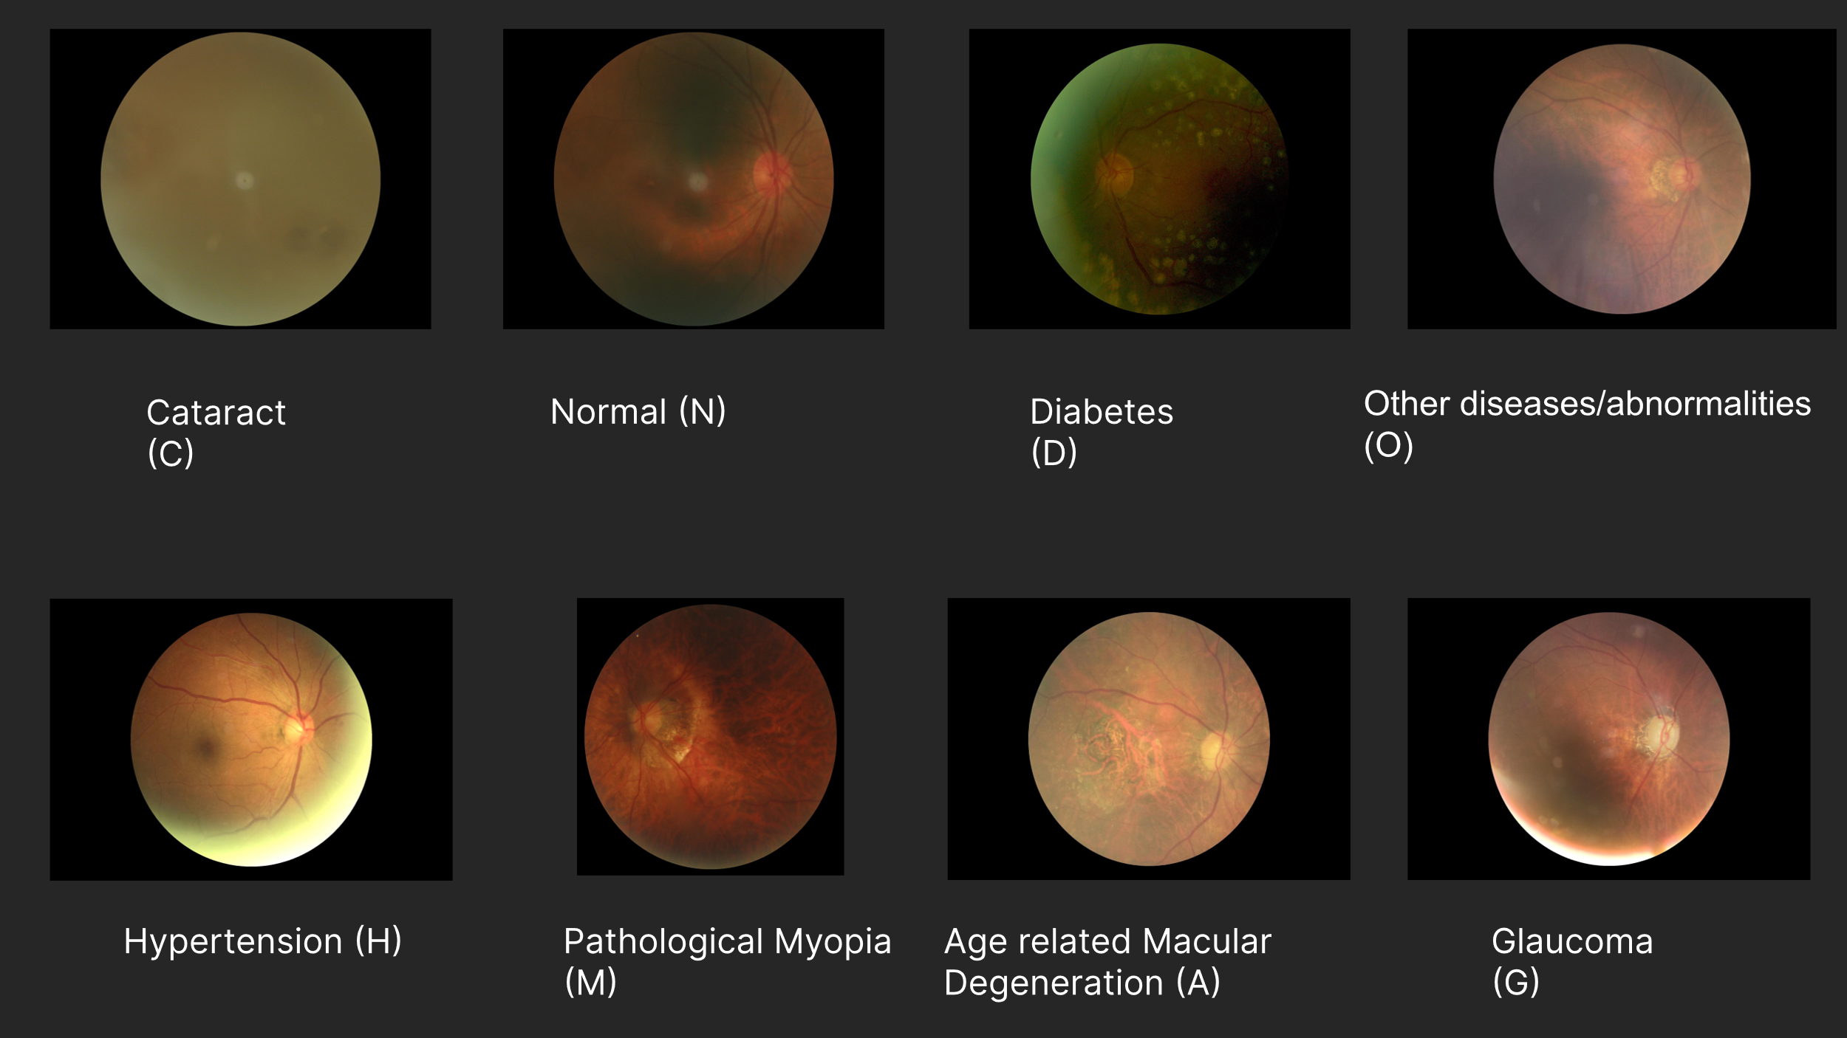
ODIR Data Samples

Slide 8
Methods
1. Masked Vision Transformer as Co-Teacher
2. Sample-wise Distillation Loss

Slide 9
Masked Vision Transformer as Co-Teacher
MViT Autoencoders are especially good at learning input data representations, thanks to their Transformer architecture which is able to attend to the whole image at once as compared to a regular CNN which can only attend to the pixel immediate neighbors.
So, in our work we use a MViT MAE as a Co-teacher which is responsible for training the student input data representation in latent space.
Typically, the MViT MAE is pretrained on large dataset such as ImageNet and the decoder is then discarded. And the encoder is combined with a classifier block and is further finetuned to do downstream tasks such as image classification
But in our method, we finetune the MAE with our dataset and then directly use the encoder as a co-teacher to train our student model.

Slide 10
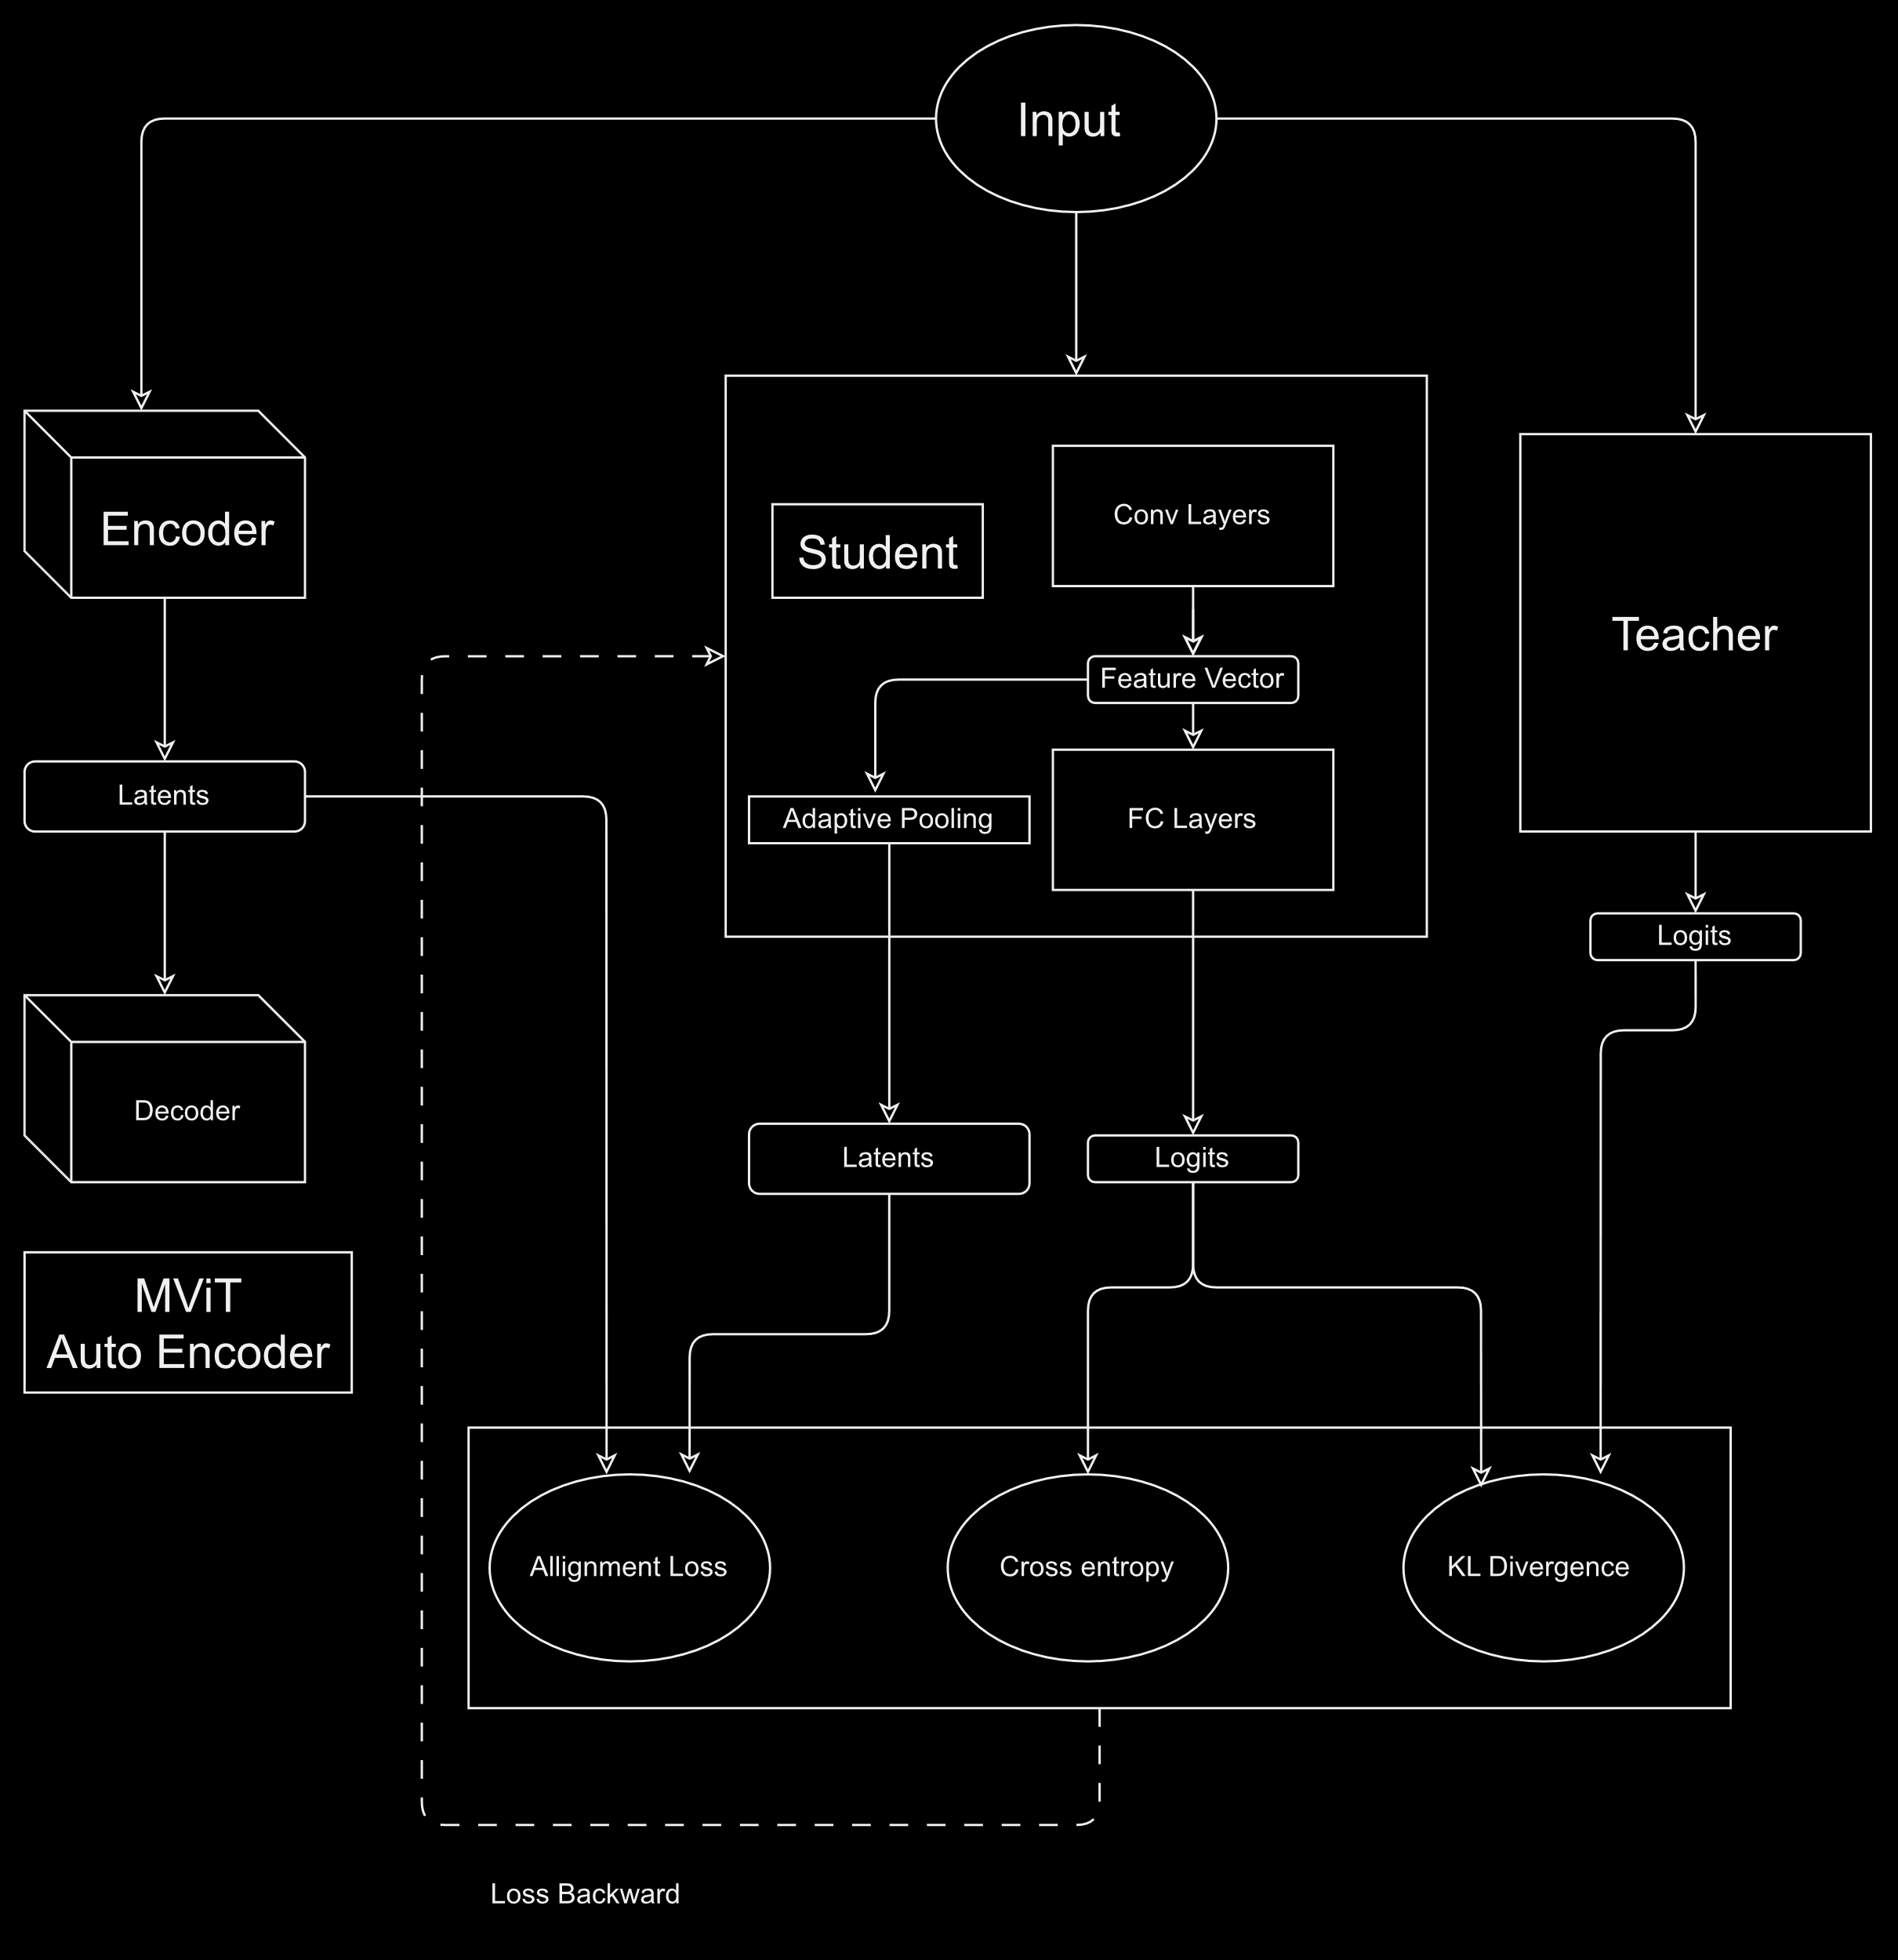
Model Architecture

Slide 11
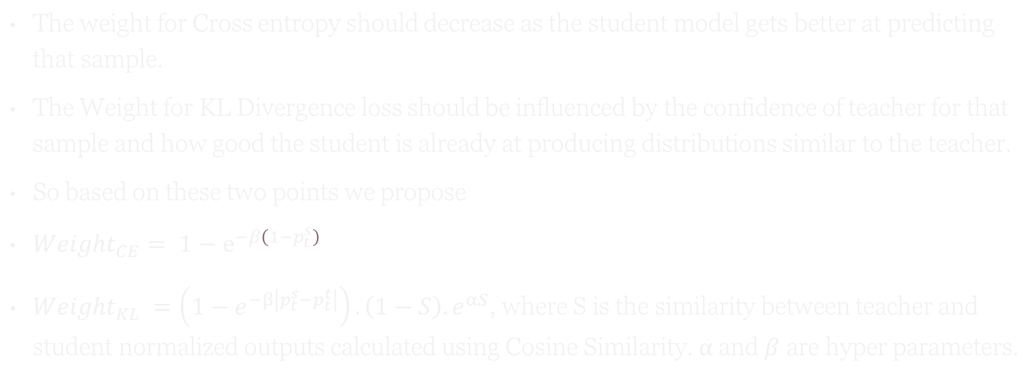
Sample-Wise Distillation Loss
The weight for Cross entropy should decrease as the student model gets better at predicting that sample.
The Weight for KL Divergence loss should be influenced by the confidence of teacher for that sample and how good the student is already at producing distributions similar to the teacher.
So based on these two points we propose
$Weight_{CE}= 1−ⅇ^{−β\left(1−p_{t}^{s}\right)}$
$Weight_{KL} =\left(1−e^{−β\left|p_{t}^{s}−p_{t}^{t}\right|}\right).\left(1−S\right).e^{αS}$, where S is the similarity between teacher and student normalized outputs calculated using Cosine Similarity. $α$and$β$ are hyper parameters.

Slide 12
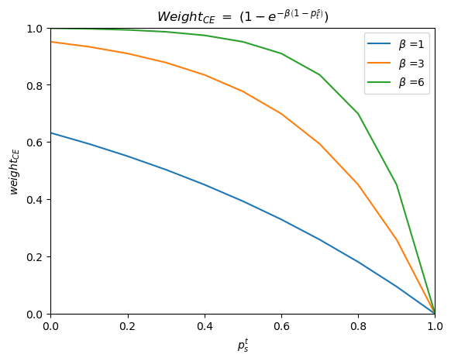
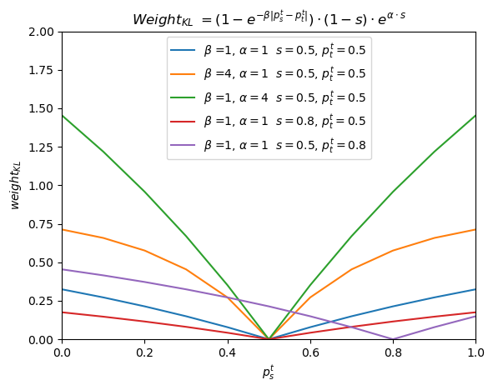
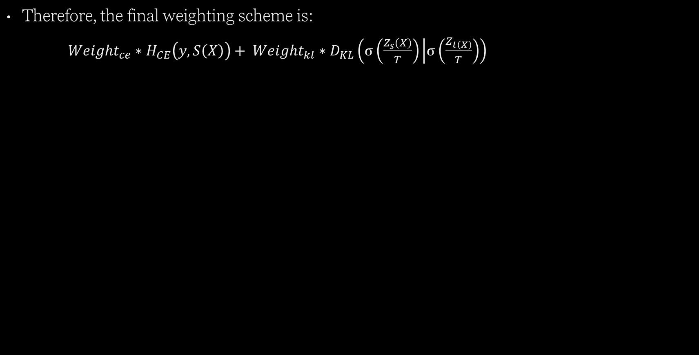
Therefore, the final weighting scheme is:
$Weight_{ce}∗H_{CE}\left(y, S\left(X\right)\right)+ Weight_{kl}∗D_{KL}\left(σ\left(\frac{Z_{s}\left(X\right)}{T}\right) | σ\left(\frac{Z_{t\left(X\right)}}{T}\right)\right)$

Slide 13
Evaluation Metric & Experimental Protocol
Training | Model | Parameters
MViT MAE finetuning | ViT Base | Image size = 224 Batch size = 64 Epochs = 50 Optimizer = Adam Base Lr = 5e-4 Absolute Lr = base_lr * total_batch_size / 256 Loss = MSE
Teacher Models | Resnet 50 | Image size = 224 Batch size = 64 Epochs = 50 Optimizer = SGD Lr = 0.01 Decay epochs = [30] Decay rate = 0.1 Loss = Cross Entropy
Student Model | Resnet18 | Image size = 224 Batch size = 16 Epochs = 240 Optimizer = SGD Lr = 0.01 Decay epochs = [150,180,210] Decay rate = 0.1 Loss = SWD Loss + Cosine Embedding Loss
Evaluation Metrics: Accuracy, F-Score.

Slide 14
Model Evaluation & Results
Method | Accuracy | F-Score | Val Loss
Finetune Resnet50 (Teacher) | 87.5 | 87.31 | 0.46
Finetune Resnet18 (Student) | 76.6 | 75.53 | 0.77
Finetune MViT encoder + classifier block | 81.5 | - | -
Hinton KD | 83.2 | 82.83 | 0.73
DKD | 83.7 | 83.60 | 0.63
RA_{CRD}¹ + KD | 83.9 | 83.53 | 0.64
SWD Loss (Ours) | 82.6 | 82.33 | 0.65
RA_{Cos}+ KD | 84.4 | 84.13 | 0.68
RA_{Cos} ² + SWD Loss (Ours) | 83.9 | 83.54 | 0.63
¹RA_{CRD} represents the Representation alignment from the MAE encoder using Contrastive Distillation loss instead of Cosine Embedding loss.
²RA_{Cos} represents the Representation alignment from the MAE using Cosine Embedding loss
ODIR: 8 Classes

Slide 15
Conclusion
Using MViT encoder as the co-teacher for teaching the input representations showed significant improvements in student performance.
Using SWD Loss alone showed a decrease in model performance, but this can be due to un optimal hyperparameters.
When using SWD Loss combined with MViT co-teacher we perform on-par if not better than most of the methods and our predictions were also more confident.

Slide 16
